Slide 1
Pydra: Hydra & Pydantic – config management

Slide 2

Hydra
Dynamic hierarchical config management tool
By composition and override it through:
config files
CLI args
Env variable
Interpolation
Multi-headed runs
Local/Remote launchers
Basic runner controls like logging etc
Runner call backs
Custom Plugins

Slide 3
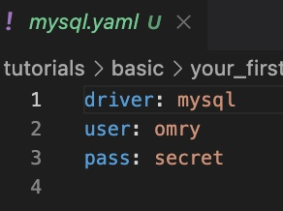
Demo: Basic config & Intro

Slide 4
Demo: Structured Config
Also:
Config Groups: Exclusive

Slide 5
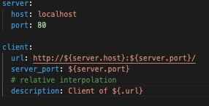
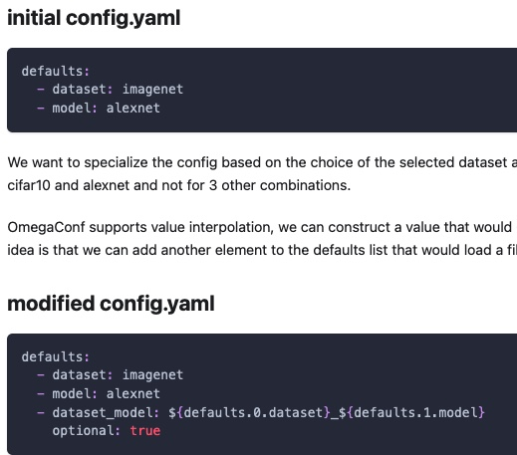
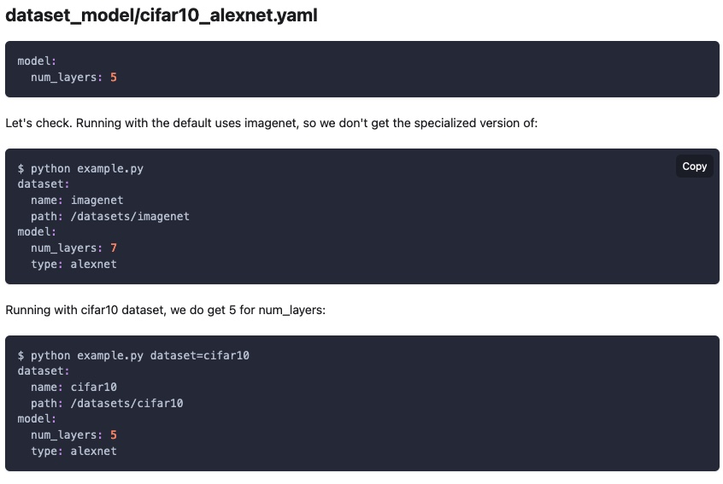
Interpolation

Slide 6
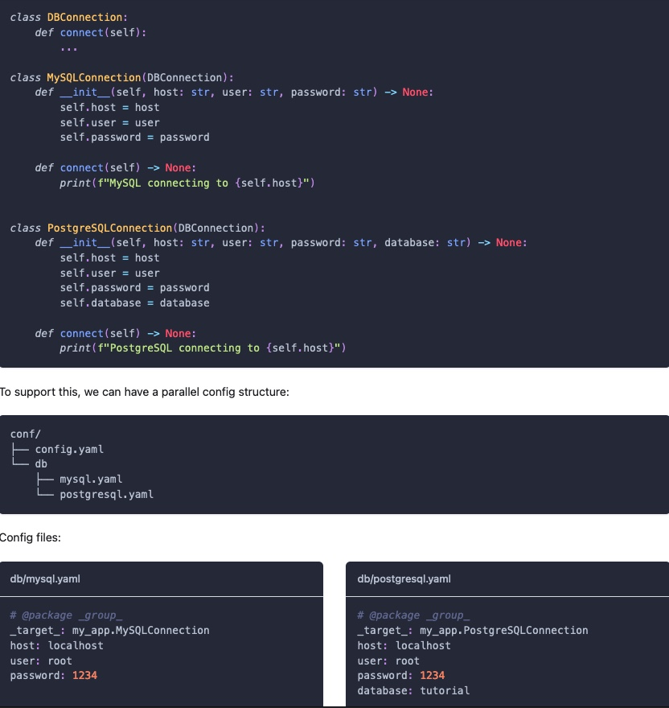
_target__

Slide 7
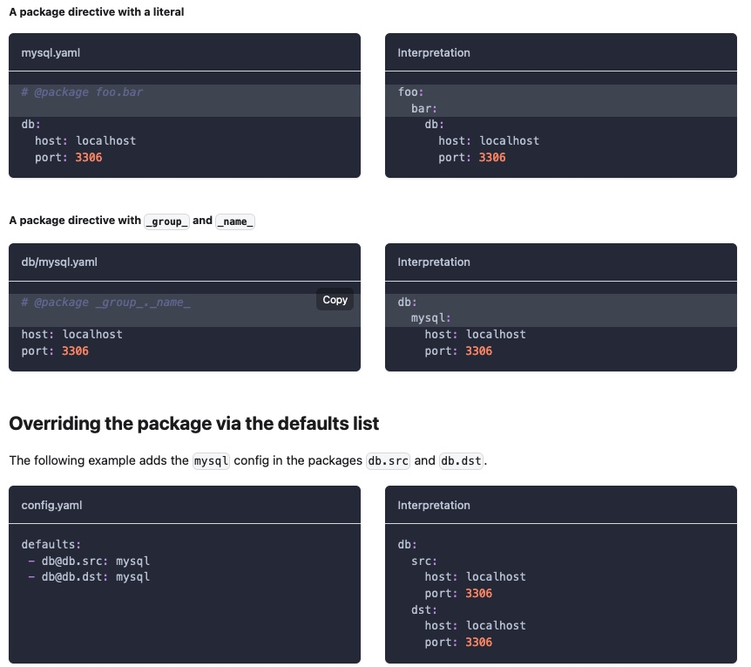
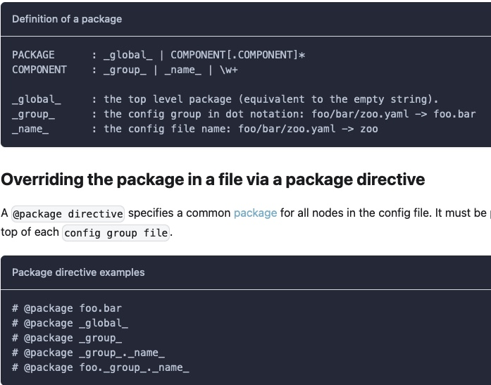
Directives
https://hydra.cc/docs/1.0/advanced/overriding_packages/

Slide 8
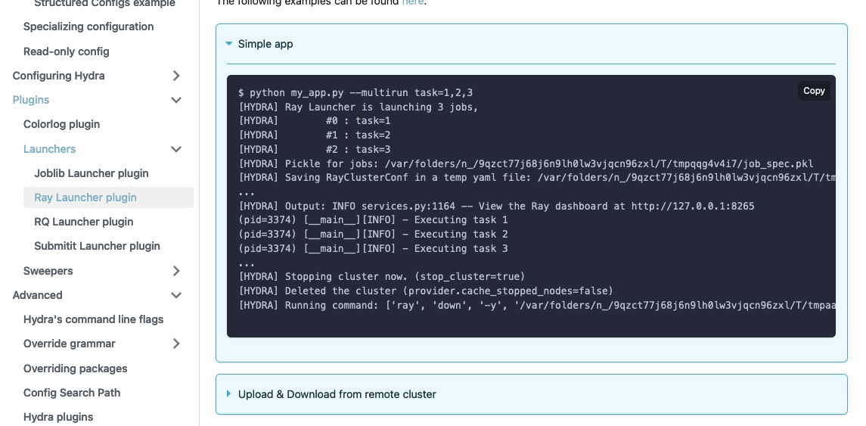
Plugins and extensions

Slide 9
Where hydra falls short?
Doesn’t work with canonical python types
Only primitives
OmegaConf does not support primitive itself
Not support for Union or Optional types
Too much rules and replacement to repurpose config: can be avoided for simplicity
structured models can only be:
POPO ☺ objects
Dataclasses or drop in replacement as such
Its structured config is foundational lacking support for:
Validations: pushes all validations including types to application
Schema enforcement and complex typing
Versioning in configs
Interpolation is rich but excludes expression/mathematical ops
There is a feature request though! https://github.com/omry/omegaconf/issues/91

Slide 10

Pydantic
Runtime type enforcement and validation:
For pure canonical python data models
Provides:
Rule enforced types for high order validation than primitives
BaseModel for handy use
Drop in replacement for python’s dataclasses with:
Additional validation
Type enforcement
Schema enforced
Can deserialize from misc serialized formats like json/xml/yaml

Slide 11

Code show
Dataclass
Validation
High order field types
BaseModel
Config
Schema
BaseSettings
Variable read from misc src
Other things for:
fwd references
ORM support
……

Slide 12
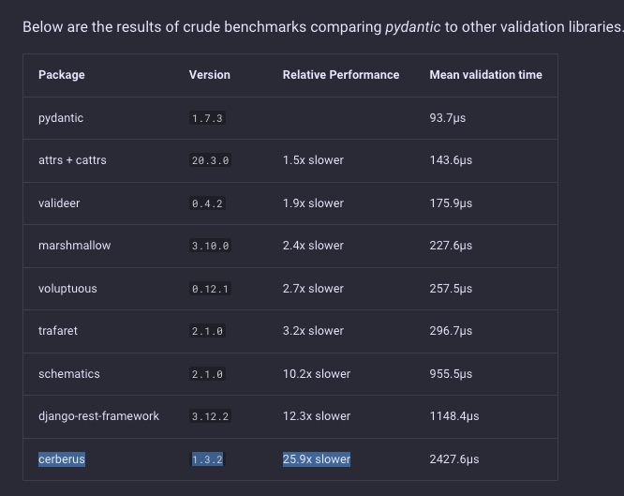
Concerns?
They no longer aggressive benchmark themself against similar tools like OMegaconf
https://github.com/samuelcolvin/pydantic/pull/3264

Slide 13
Apollo V2
Requirements:
Easily templatize hierarchical configurations of various components
Without duplication, reuse configurations cross modules where ever needed [interpolation, e.g. zoom]
Ideally support expressions like len(classes) [for class list and total class, e.g.]
Compile them into one final config after handling customization through overrides, secrets and environments settings
Be able to take the final config and reproduce the same run in reliable fashion robust to application changes
Structured config containing potentially complex, canonical python types with strong validation support beyond type hint
Versioned config and schema enforcement
Ideally, while keeping application fairly simple working with only 1 i.e. the latest version of config
So, some mechanism to support migration of preceding versioned config to latest version
Ability to integrate easily into complex distributed runs for both local and remote launch.
Choose an approach that does not works with other tools in echo system e.g. WandB

Slide 14
Apollo V2
Requirements- How are we doing:
Easily templatize hierarchical configurations of various components
Without duplication, reuse configurations cross modules where ever needed [interpolation, e.g. zoom]
Ideally support expressions like len(classes) [for class list and total class, e.g.]
Compile them into one final config after handling customization through overrides, secrets and environments settings
Be able to take the final config and reproduce the same run in reliable fashion robust to application changes
Structured config containing potentially complex, canonical python types with strong validation support beyond type hint
Versioned config and schema enforcement
Ideally, while keeping application fairly simple working with only 1 i.e. the latest version of config
So, some mechanism to support migration of preceding versioned config to latest version
Ability to integrate easily into complex distributed runs for both local and remote launch.
Choose an approach that does not works with other tools in echo system e.g. WandB

Slide 15
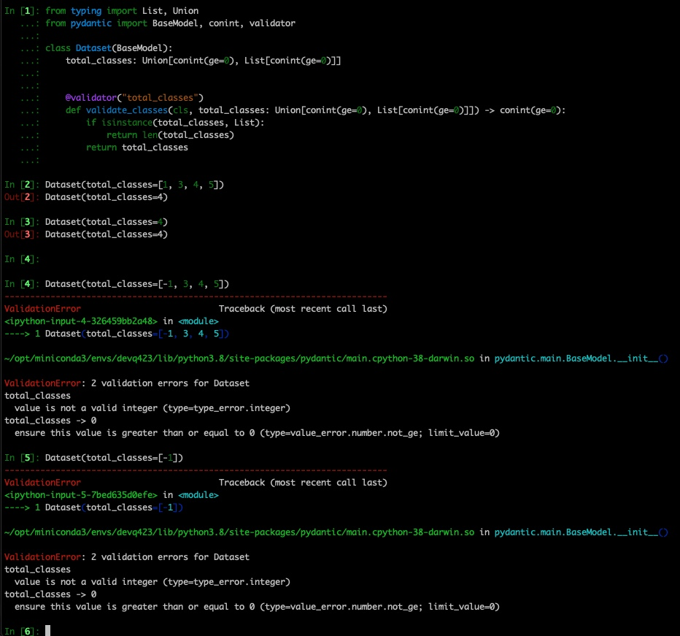
Ideally support expressions like len(classes) [for class list and total class, e.g.]
These are application logic, best placed in code.

Slide 16
Structured config containing potentially complex, canonical python types with strong validation support beyond type hint

Slide 17
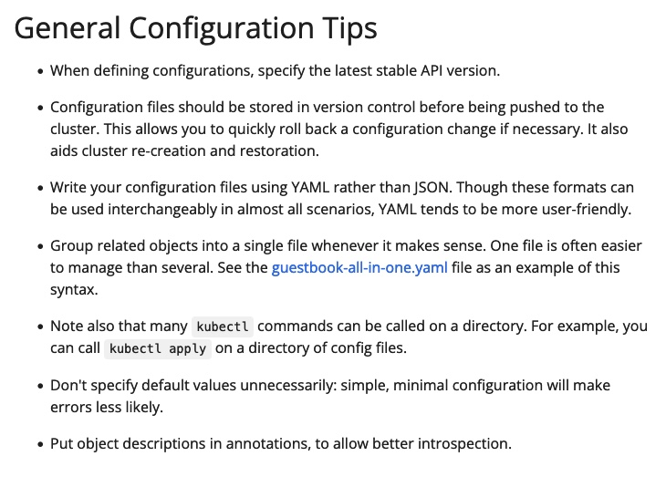
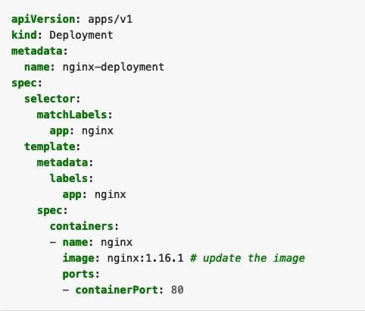
Versioned config and schema enforcement
https://kubernetes.io/docs/concepts/configuration/overview/

Slide 18
Integration with WandB
Well documented @ Link, some gotchas to look out for are:
Reports of wandb MP starts interfering with MP runs of hyra multi-run. Startup of wandb can be swapped to be thread mode as resolution.
There are some reports of conflicts b/w hydra sweeps and wandb sweeps but this is also manageable.
Notes:
https://wandb.ai/adrishd/hydra-example/reports/Configuring-W-B-Projects-with-Hydra--VmlldzoxNTA2MzQw

Slide 19


